Slide 1

Healthcare Test-Results Analytics Dashboard
Real-Time Streaming • MLlib - Powered Insights • Secure Access
5-Second Auto Refresh
Password-Protected Access
Predictive Intelligence
Live data updates for immediate clinical insights
Secure public URL with authentication
ML-driven KPIs and actionable hospital insights

Slide 2
The Challenge Hospitals Face Today
Modern healthcare generates massive volumes of diagnostic data, yet critical insights remain locked in static reports. Clinical teams need immediate access to actionable intelligence.
Volume Overload
Static Reporting
Hospitals process thousands of diagnostic results daily across labs, imaging, and testing facilities
Reports arrive delayed and non-interactive, preventing real-time clinical decision support
Limited Analytics
Delayed Decisions
Doctors lack drill-down capabilities and ML-driven pattern recognition for faster diagnosis
Information lag directly impacts treatment speed, accuracy, and patient outcomes

Slide 3




An End-to-End Smart Analytics Pipeline
We built a comprehensive solution that transforms raw diagnostic data into real-time clinical intelligence through advanced streaming, machine learning, and secure visualization.
Real-Time Streaming
Simulated data ingestion with 5-second refresh cycles mimicking live hospital systems
MLlib Intelligence
Regression, classification, and clustering models deliver predictive insights and patient segmentation
Interactive Dashboard
Streamlit and Plotly power dynamic visualizations with intuitive drill-down navigation
Secure Tunnel
Cloudflared encryption with password authentication ensures controlled access

Slide 4
Technology Stack Architecture
Each layer of our pipeline is optimized for healthcare analytics, combining proven open-source technologies with enterprise-grade security.
Layer
Technology
Ingestion
CSV / Socket Simulator
Processing
PySpark MLlib (PCA, Random Forest, Logistic Regression, K-Means)
Storage
Local CSV (Simulated Streaming)
Visualization
Streamlit + Plotly
Security
Cloudflared (Password-Protected)
Refresh
Background Thread (5s Interval)
This architecture enables scalable, real-time analytics while maintaining data integrity and access control.

Slide 5
Interactive Dashboard Capabilities
Dynamic KPIs
Live Visualizations
Track critical metrics in real-time:
Trend Analysis: Monthly and quarterly patterns reveal seasonal variations
Total tests processed
Hospital Comparison: Side-by-side performance benchmarking
Unique patients and hospitals
Doctor Metrics: Bubble charts showing volume vs. accuracy
Abnormal result percentage
Geographic View: City TreeMaps for regional insights
ML model accuracy scores
Clean, intuitive UX with light theme optimized for clinical environments
Smart Filtering
Drill down by date range, hospital, doctor, or city for granular analysis

Slide 6
Machine Learning Models & Performance
Three complementary MLlib models provide comprehensive analytical coverage, from prediction to pattern discovery. All metrics update automatically with each data refresh.
Regression
Classification
Clustering
Target: Result Value Prediction
Target: Abnormality Detection
Target: Patient Segmentation
Metric: RMSE (Lower is better)
Metric: Accuracy (Higher is better)
Metric: Silhouette Score
Forecasts numerical test outcomes based on patient history and demographics
Flags high-risk results requiring immediate clinical attention
Identifies patient cohorts for personalized care pathways

Slide 7
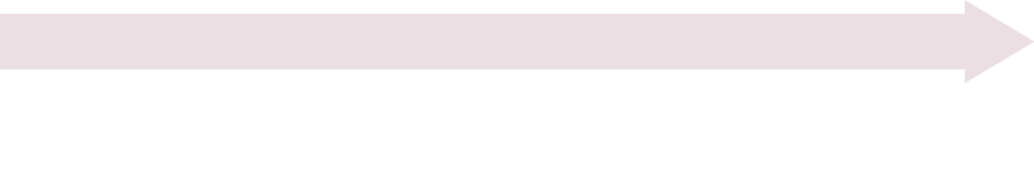

Real-Time Refresh Architecture
Our streaming simulation delivers the experience of live hospital data without the overhead of continuous model retraining.
Auto-Refresh Trigger
Data Generation
Streamlit detects file changes and automatically refreshes the dashboard interface
Background thread simulates new test results, updating CSV files every 5 seconds
Live Experience
Efficient I/O
Users see data appear in real-time, mimicking production hospital streaming systems
Chart updates use I/O operations only—no model retraining overhead on each cycle
This approach balances live data presentation with computational efficiency, ideal for demo and testing environments.

Slide 8
Security & Access Control
Cloudflared Tunnel
Password Authentication
Secure HTTPS access without exposing server infrastructure or opening firewall ports
User-defined password gate controls entry, limiting access to authorized stakeholders
Dummy Test Data
Hospital-Ready
Uses synthetic datasets with zero PHI or privacy risk—fully compliant for public demonstration
Architecture suitable for internal testing and clinical workflow validation
This security model enables safe external access while maintaining data protection standards required for healthcare demonstrations.

Slide 9

Live Demo Access
Experience the dashboard in action. All charts, KPIs, and ML insights refresh automatically every 5 seconds.
🔗 Demo URL
Click the link on your mobile device for instant access, or visit the URL above from any browser. The dashboard is fully responsive and optimized for desktop and tablet viewing.

Slide 10
Future Enhancements & Roadmap
Our current implementation demonstrates core capabilities. The following enhancements will transform this proof-of-concept into a production-grade hospital analytics platform.
Enterprise Streaming Integration
Replace simulation with Kafka or MQTT for true real-time ingestion from hospital HL7/FHIR feeds
Data Warehouse Architecture
Migrate to PostgreSQL with dbt transformations for enterprise-scale analytics and historical trend analysis
MLflow Model Management
Enable automated model retraining, versioning, and A/B testing to continuously improve prediction accuracy
Role-Based Access Control
Implement granular permissions within hospital VPN for doctors, administrators, and data analysts
Mobile Dashboard Expansion
Native mobile interface for on-the-go access by physicians and clinical teams
Thank You!
Making healthcare analytics faster, smarter, and real-time. Questions are welcome. 🤝

